Slide 1

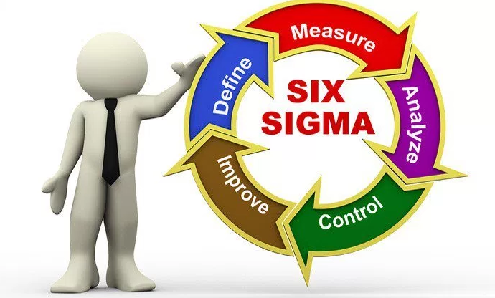

Introduction to Six Sigma
المعهد التكنولوجى لهندسة التشييد و الإدارة
Prepared By:
Said Fawzy
Manager of Information Center –Quality manager
Tendering Department
Arab Contractors

Slide 2
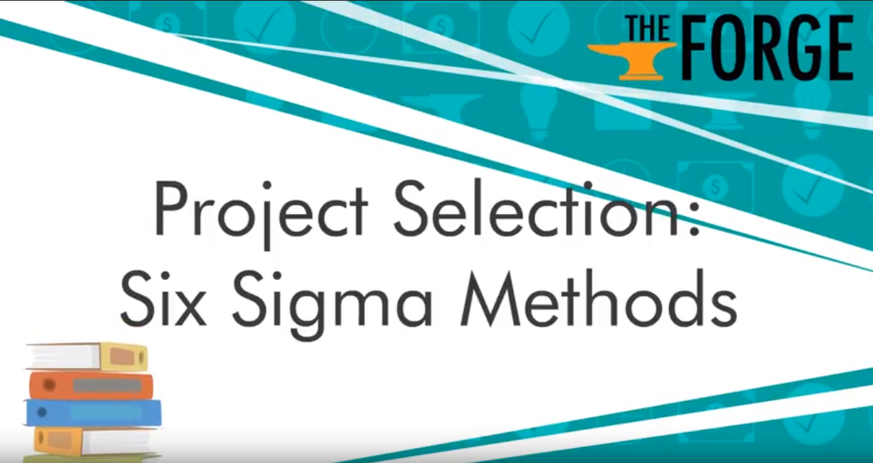

Slide 3


Slide 4
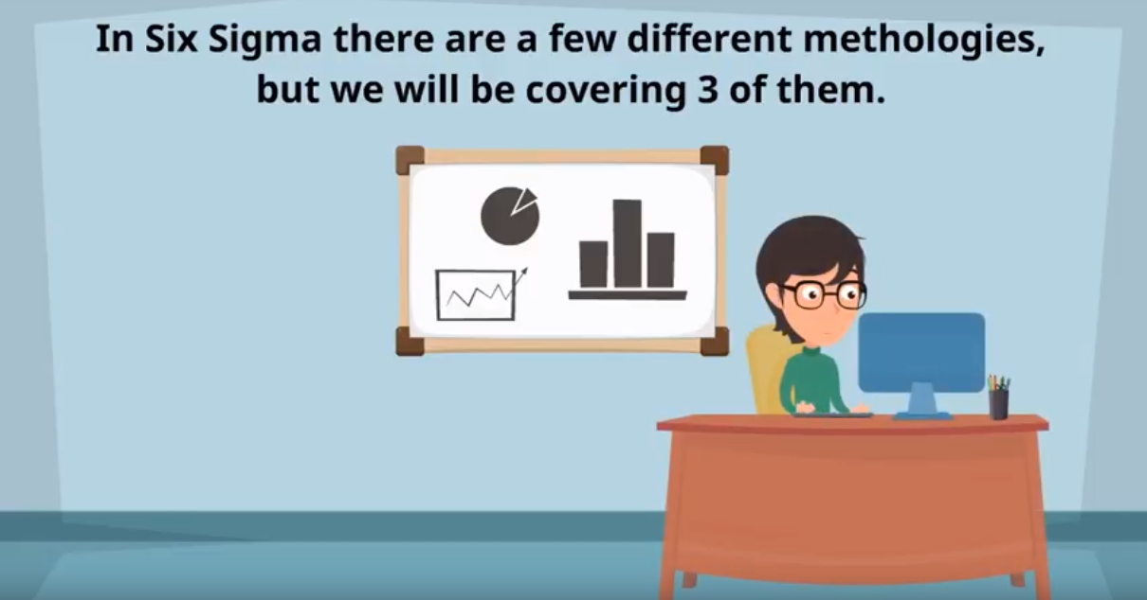




Slide 5
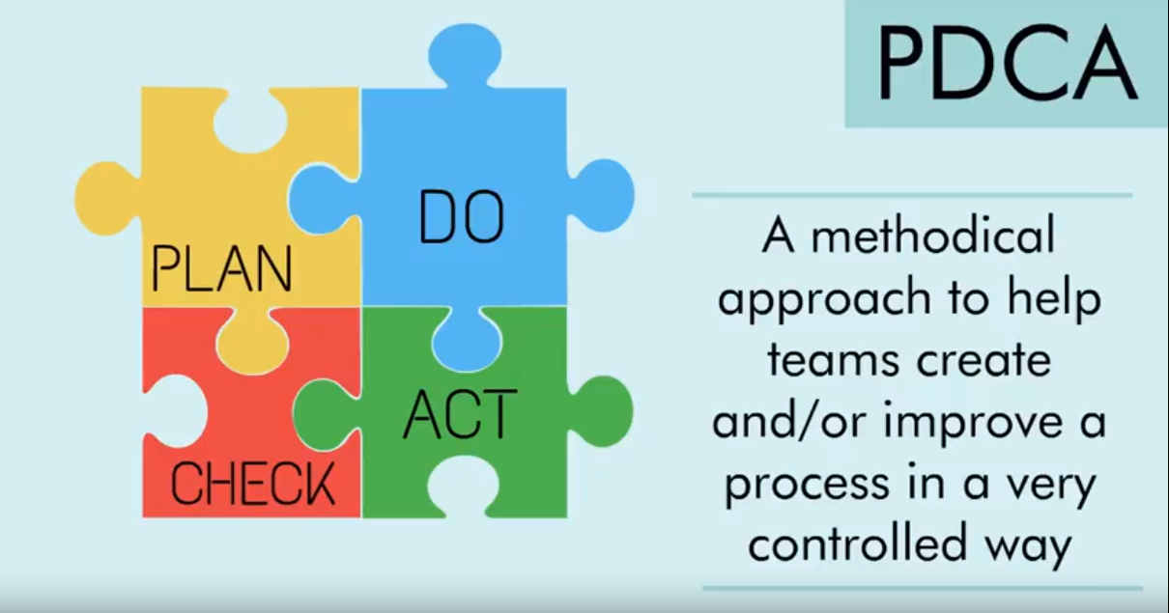

Slide 6
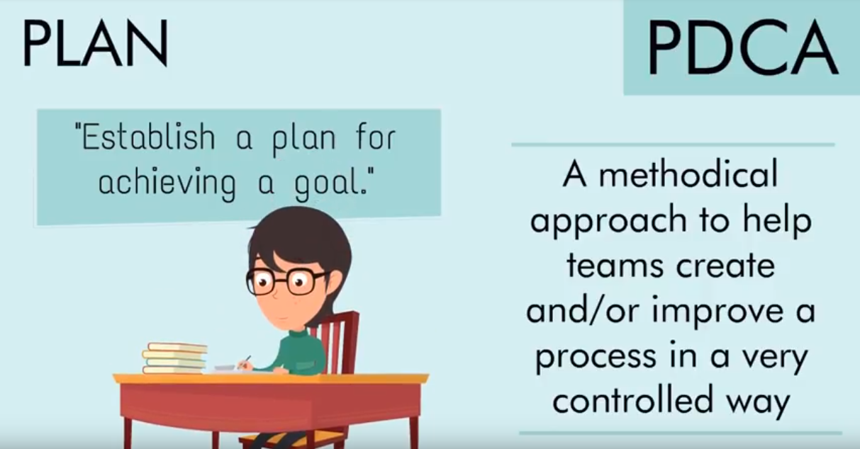

Slide 7
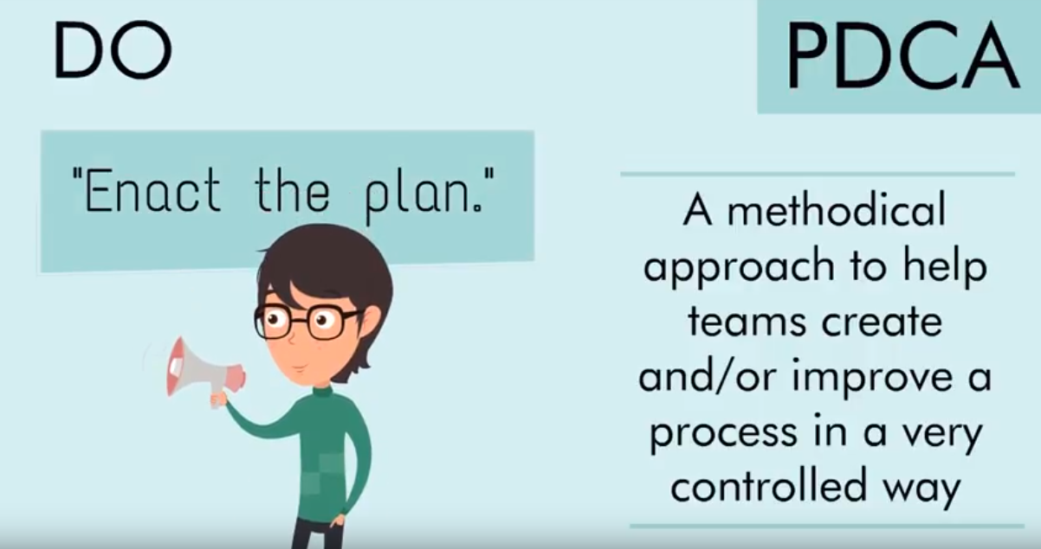

Slide 8
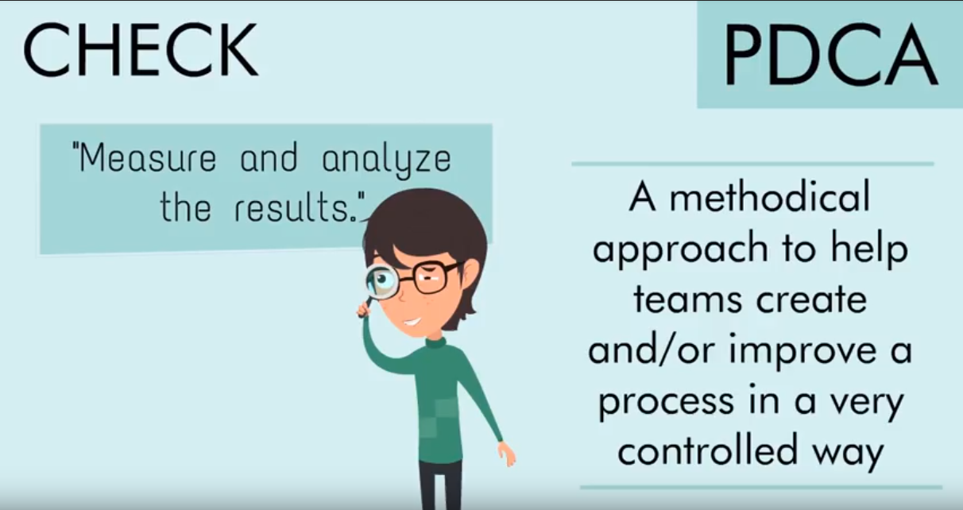

Slide 9
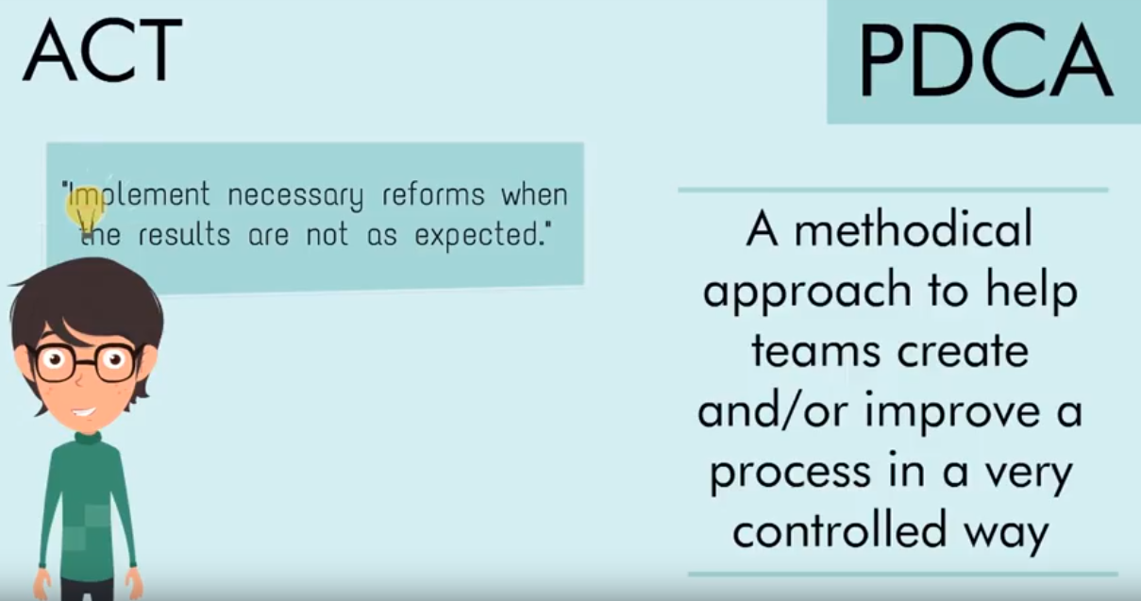

Slide 10







Slide 11




Slide 12

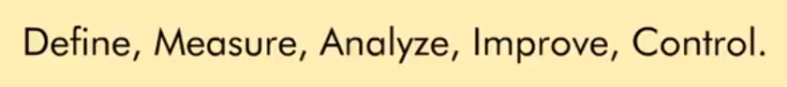



Slide 13


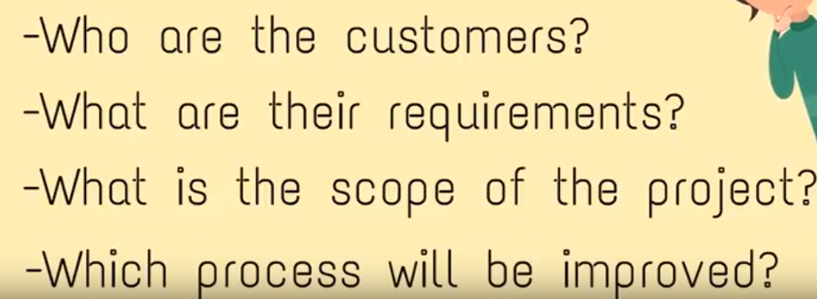

Slide 14


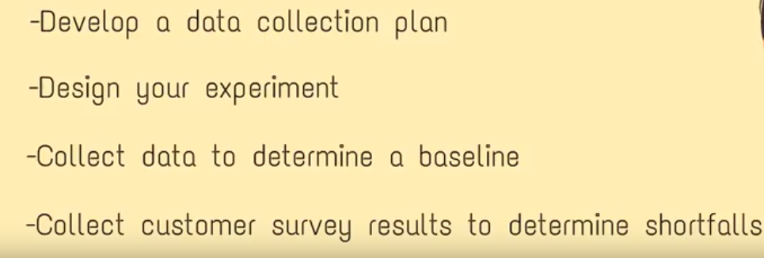

Slide 15


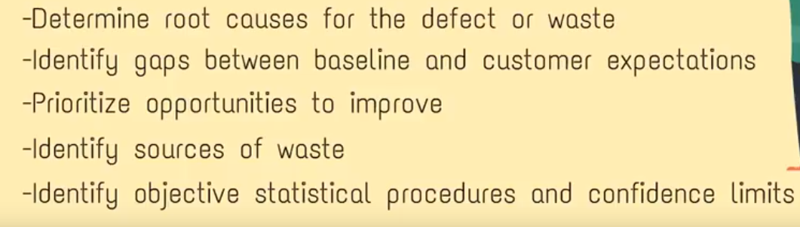

Slide 16


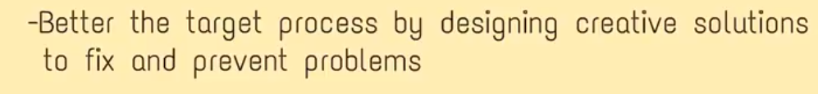


Slide 17


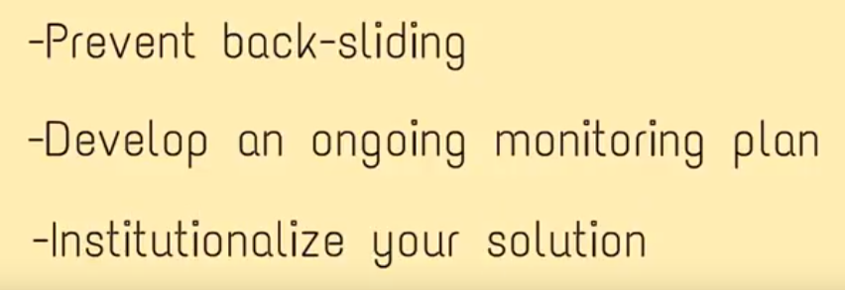

Slide 18
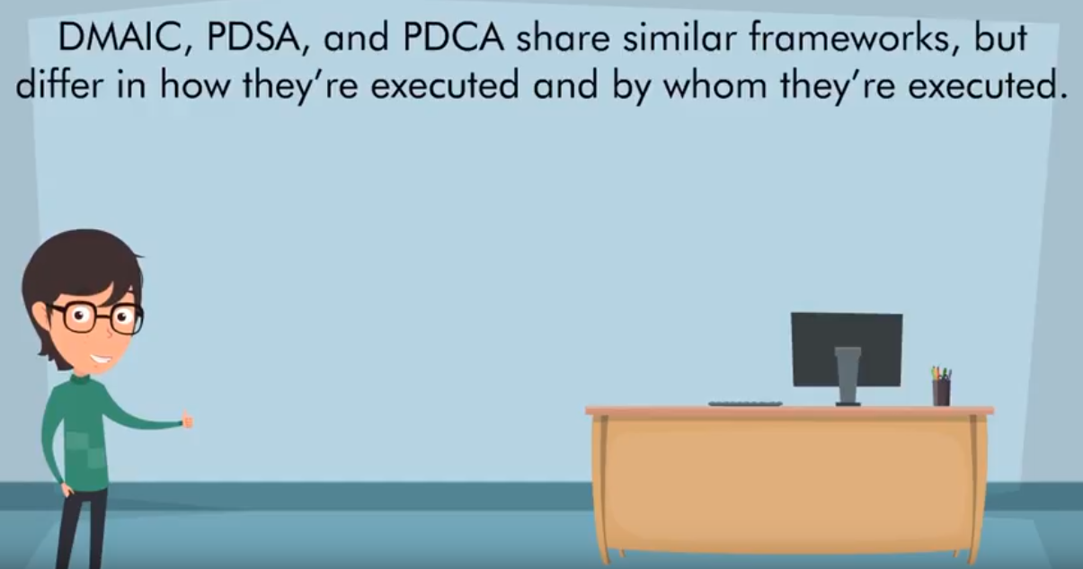

Slide 19
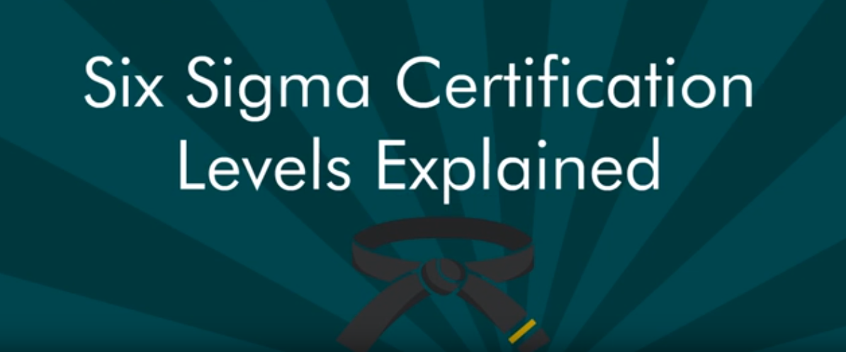

Slide 20

these certification levels demonstrate the level of knowledge and experience a person has working with Six Sigma

Slide 21
The levels do not have to be completed in order some people go straight to Six Sigma green or black belt and skip the others

Slide 22

white belt novice introduction to concept

Slide 23

companies may hold white belt classes to introduce their employee base to Six Sigma and the concepts often that beginning of breeding such a program to their operations

Slide 24
This type of class may introduce some terms and assimilation to show the significance of the program and value to the positive changes they hope to see

Slide 25

yellow belt participant introduction to project methodology

Slide 26

people identified as subject matter experts to participate actively on a project or given additional training so they understand what to expect and how a project evolves methodically

Slide 27

while yellow belts don't need a project it's helpful for them to have solid understanding of how their project leader will conduct the project

Slide 28

This type of certification is usually given through the employer and may or may not include an exams

Slide 29

green belt project leader 20 percent of overall duties the Six Sigma projects

Slide 30

A green belt has a regular job but dedicates up to 20 percent of their work to a project that they are running

Slide 31

they are accountable for the progression and results of the project by leading the yellow belts through the process

Slide 32

blackbelt project leader 100% dedication to six sigma

Slide 33

black belts live and breathe Six Sigma they may have a title related to quality ie quality leader quality analysts etc or process process engineer process analyst etc whichever title

Slide 34

their entire job is the success of improving quality or efficiency of the company

Slide 35

in addition to running the more complex or high-profile projects they also mentor the green belts and monitor their projects and share accountability for their project success

Slide 36

master black belt program Peter 100% dedication to Six Sigma

Slide 37

these leaders may hold a senior management level from manager to VP depending on the corporate structure

Slide 38

they manage the black belts and answer to the steering committee for executive leadership the success of the overall program

Slide 39

Executive sponsorship is essential in an effective Six Sigma program it sets the direction and priorities of the organization

Slide 40

The executive team is comprised of the leaders that will communicate lead and direct the company's overall objectives toward successful and profitable Six Sigma deployment

Slide 41

executives typically receive training that includes an overview of Six Sigma examples o successful strategies with tools and methods for the DMAIC processes

Slide 42

champion Six Sigma champions are usually upper level managers that control and allocate resources to promote process improvement and black belt development

Slide 43
champions are trained in the core concepts and deployment strategies used by their organizations with this training champions leap and implementation of the Six Sigma program

Slide 44

they also work with black belts to ensure that management is aware of the status of program deployment and that resources are available for training and project completion they are involved in all project reviews in their area of influence

Slide 45

process owner key processes should have a process owner

Slide 46

a process owner coordinates or engages process improvement activities and monitors the progress process owners

Slide 47

work with black belts to improve the process for which they are responsible they should have basic training in the course statistical tools but will gain proficiency only with those techniques used to improve their individual processes

Slide 48

Sometimes they may also serve as champions or sponsors

Slide 49


